Slide 1
Overdispersion Part 2
Eric Scott

Slide 2
Overdispersion Part 2
Packages you’ll need for today:
MASS
pscl
Optional for making maps:
maps
mapproj
install.packages(c(“MASS”, “pscl”))

Slide 3
Exam Revisions
1 week to revise exams. Final grade = average of original and revised
Revise only questions you want to but be sure to carry through changes to subsequent questions when appropriate.
Turn in original and revisions together
Monday’s lab will be time for you to get help from Avalon with revisions
I will likely assign a homework on Tuesday, so manage your time well.

Slide 4
Feedback
Thank you all for putting so much thought into the feedback forms!
Results:
Count | What’s not so good?
4 | posted slides not complete (enough)
3 | pace too fast
3 | go over code in lecture more / better
2 | too much math / too much time spent on equations
1 | not enough math / not enough time spent on equations
1 | not having code before lecture
1 | better translation from math/concept to code
1 | classroom uncomfortable
Count | What’s good?
10 | examples
5 | slides
4 | sample code / demo in R
2 | group work / practice in class
2 | using chalkboard / visuals
1 | homework solutions
1 | working through math
1 | recap at end of lecture
1 | pace

Slide 5
Feedback
Count | Suggested Changes
5 | more in-class coding / other activities
3 | slow down pace
3 | post code before class
2 | provide learning objectives
1 | more recaps
1 | more “why”, less “how”
1 | more chalkboard
1 | post lectures before class
1 | post notes (like first few lectures)
1 | change order of lectures

Slide 6
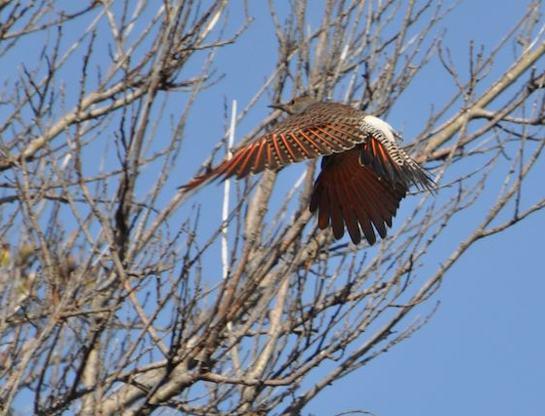
Flickers
I posted code for Tuesday’s example in flickers.nb.html on Canvas.
Data found in the datasets folder
Copy and paste (or download) code and get it to run.
Today we’ll go through a different example, but you can use the flicker analysis for reference

Slide 7
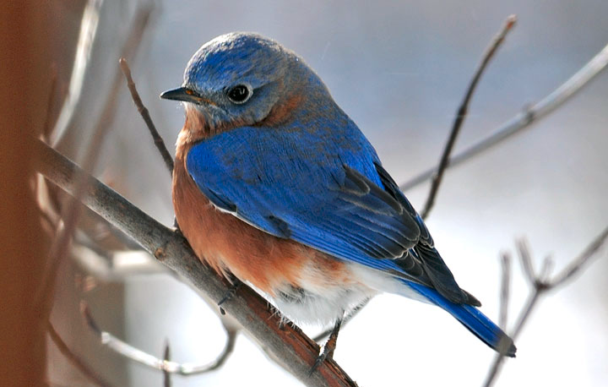
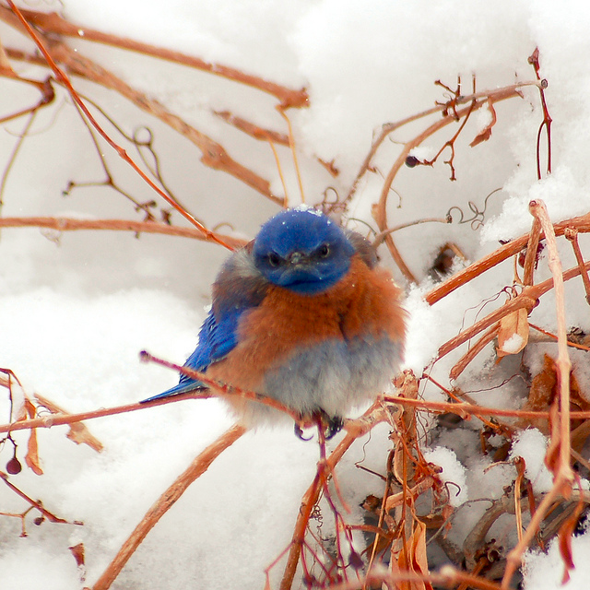
www.christmasbirdcount.org

Slide 8
Eastern Bluebirds
Migrate short distances south in the winter
Can be found year-round in most of New England
Looks like maybe there’s a trend with latitude
Download bluebirds.Rmd and bluebirds.csv from Canvas to follow along

Slide 9
Overdispersed?
Load the dataset (bluebirds.csv) into R and check if it’s overdispersed by doing one (or more) of the following:
Calculating mean and variance of the counts or counts per 100 hours
Fitting Poisson GLM that estimates a trend with latitude and looking at residual deviance and residual degrees of freedom
Plotting a histogram or bar plot of the data to look at the shape

Slide 10
Fit a Zero-Inflated Poisson
When fitting a ZiP model with a predictor variable, you can choose to model it so that:

Slide 11
Fit a Zero-Inflated Poisson
When fitting a ZiP model with a predictor variable, you can choose to model it so that:
The predictor affects the count portion of the model (i.e. the average # birds given the habitat is suitable varies with latitutde)
zeroinfl(Count ~ latitude | 1, data = birds2)

Slide 12
Fit a Zero-Inflated Poisson
When fitting a ZiP model with a predictor variable, you can choose to model it so that:
The predictor affects the count portion of the model (i.e. the average # birds given the habitat is suitable varies with latitutde)
The predictor affects the zero portion of the model (i.e. the habitat suitability varies with latitude)
zeroinfl(Count ~ 1|Latitude, data = birds2)

Slide 13
Fit a Zero-Inflated Poisson
When fitting a ZiP model with a predictor variable, you can choose to model it so that:
The predictor affects the count portion of the model (i.e. the average # birds given the habitat is suitable varies with latitutde)
The predictor affects the zero portion of the model (i.e. the habitat suitability varies with latitude)
The predictor affects both counts and zeroes
zeroinfl(Count ~ Latitude|Latitude, data = birds2)

Slide 14
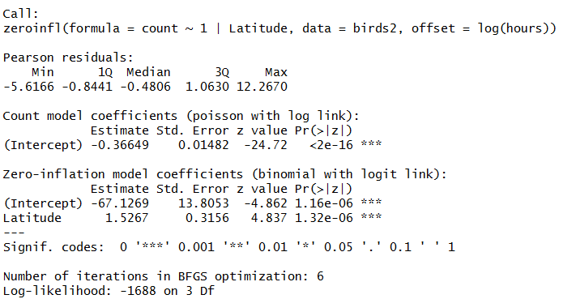
Predictor variables for count term
Predictor variables for zero term
Coefficient for count term
Log-scale mean
Coefficients for count term
Logit-scale intercept & slope

Slide 15

Predictor variables for count term
Predictor variables for zero term
X

Slide 16
Fit ZiP models
Fit three ZiP models describing a trend with latitude:
Effect of latitude on probability that bluebirds migrated (and aren’t in the sites)
Effect of latitude on number of bluebirds given they are present
Effect of latitude on both presence and number given they are present
Use AIC to compare
Which is best supported?

Slide 17
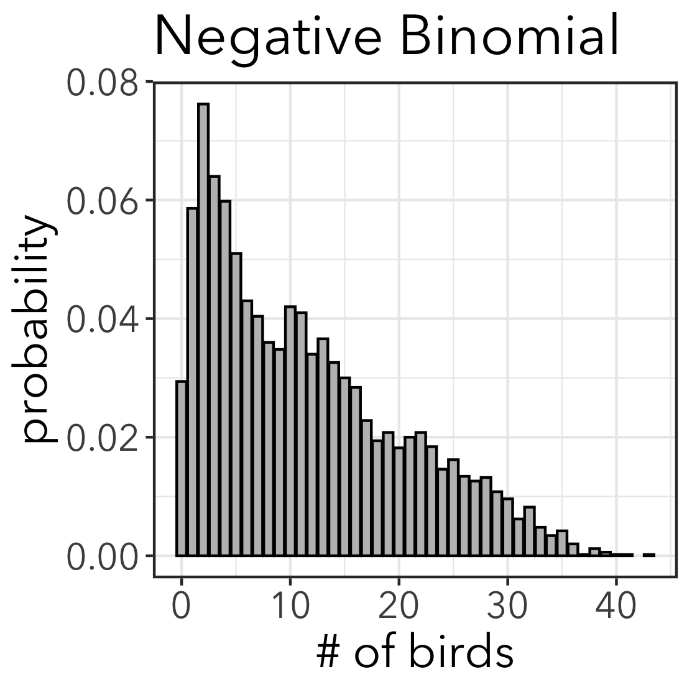
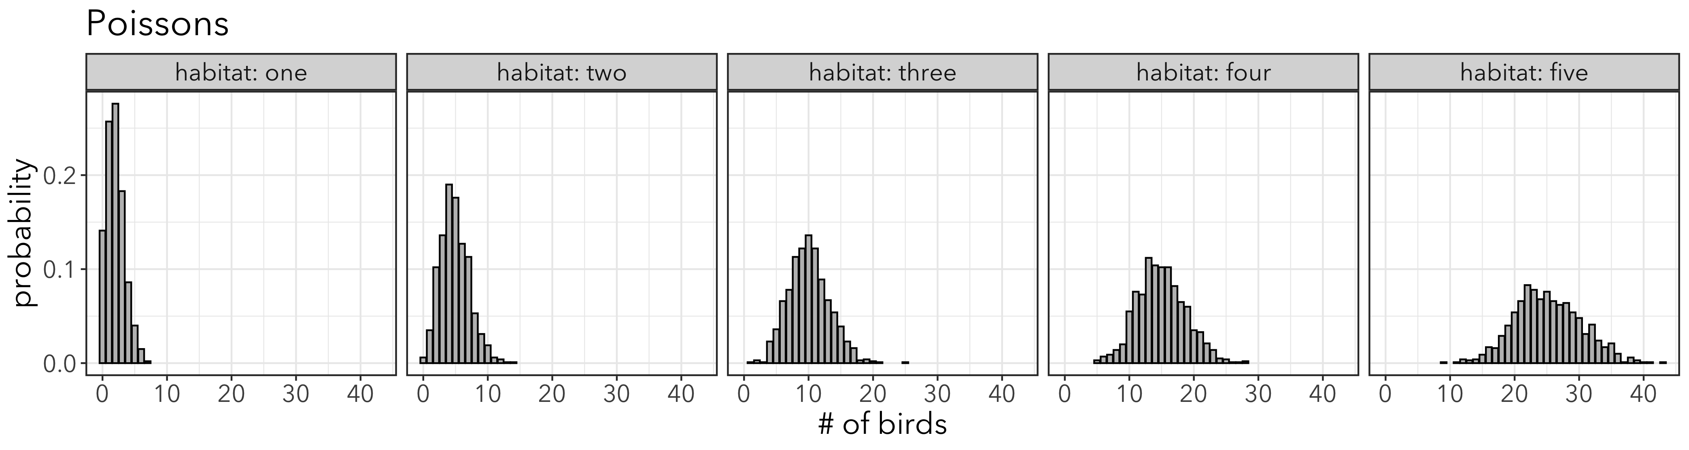
Another source of overdispersion
What if habitat quality varies over the landscape?
Some sites will have higher expected counts than others = different Poisson distributions.
Expected Poisson distributions from different habitats
∑( )=
Low Quality → High Quality
Axioms of Probability: OR rule

Slide 18
Negative Binomial
Combination of Poissons defined by 𝜆, but 𝜆 is a random variable with a “gamma” distribution.
Parameters:
µ (mean expected counts)
θ (theta, the dispersion parameter)
Mean: E(Y) = µ
Variance: var(Y) = µ + µ²/θ
What’s the deal with the name?
It is related to the binomial distribution (so is Poisson), but honestly, it’s not clear to me.

Slide 19
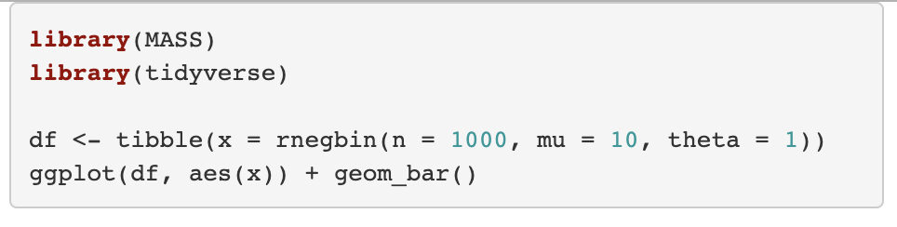
Try it out
Get a feel for the negative binomial distribution by changing the theta parameter in this code and re-running it.
What happens when mu < theta?
Does a smaller theta mean more or less spread in the data?

Slide 20
Fit a Negative Binomial Model
The MASS package includes a glm.nb() function to fit negative binomial GLMs.
No need to provide family =
Estimates theta in addition to linear coefficients
To fit a negative binomial GLM use:
glm.nb(Count ~ Latitude, data = birds)
To add an offset, can’t use offset =
glm.nb(Count ~ Latitude + offset(log(hours)), data = birds)
Notes:
Can do this in regular GLM too. Doesn’t make a difference. Try this now!

Slide 21
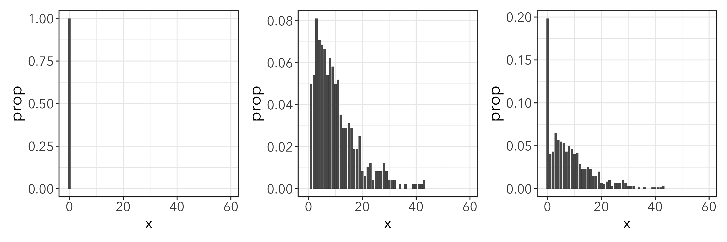
Zero-inflated Negative Binomial
Binomial
Negative Binomial
ZiNB
“OR” rule
Notes:
Replace graphic!!!

Slide 22
Fitting a ZiNB
An option with zeroinfl()
zeroinfl(Count ~ latitude|latitude, offset = log(hours), dist = “negbin”, data = birds2)

Slide 23
Predictor variables for count term
Predictor variables for zero term
X

Slide 24
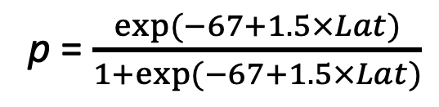
p = $\frac{exp⁡(−67+1.5×Lat)}{1+exp⁡(−67+1.5×Lat)}$
Y = plogis(-67 + 1.5*latitude)
Latitude

Slide 25
Model Selection
Choose distribution (use model with predictors)
From 1st principles
From model competition with AIC (e.g. Poisson, negative binomial, ZiP)
Test significance of predictors
LRT of nested models
AIC of competing models
OR
OR

